Slide 1
Wireless Innovation Forum Advocacy Agenda
Advocating for the innovative utilization of spectrum,
Advancing radio technologies

Slide 2
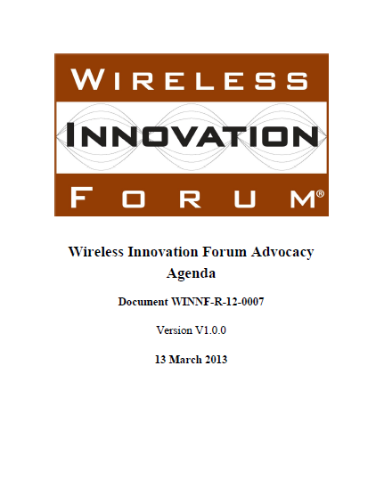
Focus Areas
Essential and Critical Communications
Innovation & Competition
Spectrum
Security
Interoperability

Slide 3
Essential and Critical Communications
Notes:
Essential and critical communications systems are those systems where loss of communication can cause injury or death or lead to a loss of civil order. Such systems must be fault tolerant, protected from failures that can occur from intentional acts from vandals, criminals or terrorists, accidental interruptions such as weather related power outages or natural disasters which can damage infrastructure and make it unusable, or due to human error in either management of the system or in its regulation.

Slide 4
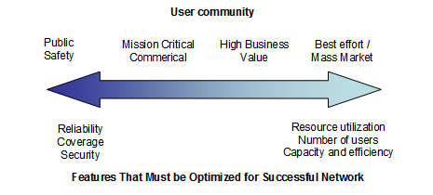
1.1 Essential and Critical Communications need Special Consideration
The Forum advocates for
  highly available
  fault tolerant,
  secure, and
  extensible
system architectures for essential and critical communication.
Essential and Critical Communications
Notes:
The Forum advocates for highly available fault tolerant, secure, and extensible system architectures for essential and critical communication. Commercial communication architectures are generally not appropriate for essential and critical communications. Maintaining high availability in essential and critical communication systems therefore requires that such systems cannot rely solely on fixed infrastructures with single point of failures. Instead, an integrated architecture strategy must be fault tolerant, which allows for failures by utilizing self-repairing or self-healing technologies and layered soft-fail mechanisms that trade channel efficiency for system robustness. In many cases essential and critical communications systems must also be extensible to allow interoperability with other services as required, and this needs to be built into the design from the start. Such systems also often require enhanced security to authenticate the users and ensure that communications are delivered only to the intended recipients.
In developing such systems, it is important to recognize the value proposition of the users. Users of essential or critical communications systems are not necessarily interested in the means by which capability is provided, as long as certain requirements such as guaranteed coverage, high availability, reliability and ease of use are fulfilled. Users are consumers of capabilities provided by advancement in technology. As communication technology evolves beyond the simple ability to deliver bits, to advanced capability to delivery data, information and knowledge to the user, the user and the users mission becomes an essential element of the communications architecture.

Slide 5
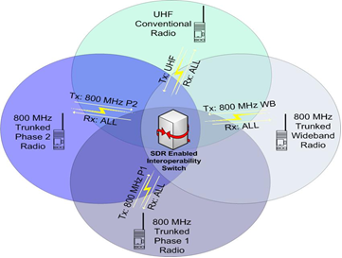
1.2 Use of SDR, CR and DSA Technologies
The Forum advocates for the use of SDR, CR and DSA as the best way to leverage commercial technologies and standards to meet the needs of Essential and Critical Communication systems.
  Multi-band/Multi-service
  Capacity extension
  Network re-optimization
  Situational access to spectrum
Essential and Critical Communications
Notes:
The Forum advocates for the use of SDR, CR and DSA as the best way to leverage commercial technologies and standards to meet the needs of Essential and Critical Communication systems. The use of SDR, CR and DSA technologies allow for the multi-band/multi-service radios that support essential and critical communications via voice and data signals on demand, in real time, when needed, and as authorized. Through these technologies, open commercial standards can be utilized where appropriate to achieve goals such as commonality of function, facilitation of a multi-vendor environment and affordability. These technologies are most effective when utilized in conjunction with associated modifications to network, infrastructure security, regulation, and operational procedures, to provide advanced support for the ad-hoc, self-optimizing network structures often required for operation in disastrous and emergency conditions. Such situations include loss of power scenarios or requirement for support in areas where infrastructure has been compromised or not been built out. SDR and CR have been shown to be key enablers of flexibility for configuring operating frequencies and radio parameters of the repeaters, base stations, and portables to allow operation and mitigate interference in these types of systems. This flexibility allows for infill coverage, capacity extension and rules based network re-optimization of communication systems. SDR, CR and DSA can also be utilized to access spectrum beyond what is allocated when demand exceeds capacity. Such spectrum could include unlicensed spectrum (WiFi, TV White Space) as well as spectrum made available under some other pre-defined agreement.

Slide 6
1.3 Dynamic, Situational Prioritization
The Forum advocates the use of dynamic, situational prioritization of network and spectrum resources to optimize communications to meet the mission needs.
Authorized by Requested by | Individual Responder | Central Authority | Network
Individual Responder | Priority is controlled by individual responder | Individual requests are granted “manually” by central authority, would not require cognitive capabilities. | Cognitive capability to respond to individual request.
Central Authority | Priority changes are initiated by central authority and “accepted” by individual responder. | Central authority makes unilateral decisions regarding individual responder priorities. | Cognitive capabilities in the communications network evaluate requests initiated by central authority
Network | Cognitive capabilities in network “recommend” priority change to individual responder who must “accept” the change. | Cognitive capabilities in network “recommend” priority changes to central authority who must “accept” the change. | Fully automated capability for priority management with no human in the decision loop.
Essential and Critical Communications
Notes:
The Forum advocates the use of dynamic, situational prioritization of network and spectrum resources to optimize communications to meet the mission needs. These needs were identified in a report, which analyzed a chemical plant explosion scenario to develop and convey concepts for the application of cognitive radio technology to enhance the communications capabilities of public safety first responders. This report concludes that reconfiguring user radios and prioritizing the network resources appropriately can ensure that the communications channels are used for the highest priority needs, for both the incident as well as ensuring resource availability required for continuity of ongoing operations away from the incident. In addition, dynamic spectrum access and dynamic prioritization could interact such that responders with the appropriate prioritization could utilize dynamically allocated spectrum to maximize access for the highest priority users.
Policy awareness is required to operate agilely across multiple bands and in multiple locations. These policies include regulatory and system specific behaviors. Fixed and variable policies can determine when spectrum is considered as opportunity to utilize as well as provide constraints on using identified spectrum opportunities. Policy based radios using machine interpretable policies are the preferred approach to managing the dynamic aspect of communication systems. The core ontology as defined in the Forum’s Modeling Language for Mobility, Description of the Cognitive Radio Ontology, WINNF-10-S-0007, makes it possible to express the use cases and support autonomous policy based radio control.

Slide 7
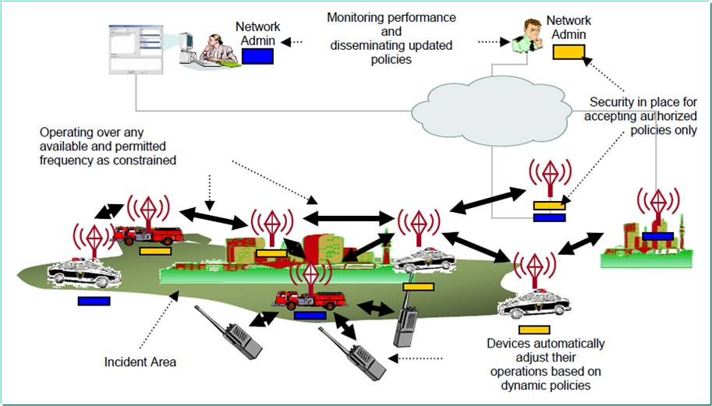
1.4 Dynamic Access of Spectrum
The Forum advocates for the capability to dynamically access additional spectrum for essential and critical communication users.
Essential and Critical Communications
Notes:
The Forum advocates for the capability to dynamically access additional spectrum for essential and critical communication users. First responder demand for spectrum access can rise dramatically during major incidents and disaster responses. Exclusive assignment of spectrum to public safety and other critical / essential communication systems is necessary (see section 3.1.1) though expensive and can result in under-utilization of spectrum during normal operations over large geographical areas. However, large numbers of responders operating during a crisis can easily over-burden the planned system capacity in a localized region. As recommended by the PCAST report “Realizing the Full Potential of Government Owned Spectrum to Spur Economic Growth”, mechanisms for shared access to spectrum are necessary to ensure that public safety users can access needed spectrum with appropriate priority during times of need, while allowing commercial use for the remainder of the time. The forum advocates appropriate mechanisms are established to ensure that essential and critical communications receive the appropriate priority for dynamic access of the spectrum, also see section 3.2.3 of this document.

Slide 8
Innovation & Competition

Slide 9






2.1 Government Strategic Investment
The Forum advocates for government strategic investment of joint research and development between industry and academia; in particular to address industry needs identified in the Wireless Innovation Forum’s ten most wanted innovations list
Innovation and Competition
Notes:
The Forum advocates for government strategic investment of joint research and development between industry and academia; in particular to address industry needs identified in the Wireless Innovation Forum’s ten most wanted innovations list. The Wireless Innovation Forum’s Top 10 list identifies major technical, business or regulatory innovations required for future generations of wireless devices. The Forum believes these innovations, would address various shortcomings in existing wireless communications from the point of view of the different stakeholders in the wireless industry value-chain. Key stakeholders include users, radio and platform manufacturers, software and hardware component providers, operators and service providers, as well as spectrum regulators.

Slide 10

Spectrum Test Beds and Test Cities
The Forum advocates for the establishment and utilization of real world Spectrum Test Beds and Test Cities to mature and validate Cognitive Radio and Network technologies.
  Cambridge
  South Africa
  Wilmington
  Humbolt
  Others
Progression from controlled environment to “real-world” trials
Innovation and Competition
Notes:
The Forum advocates for the establishment and utilization of real world Spectrum Test Beds and Test Cities to mature and validate Cognitive Radio and Network technologies. Industry and academia have been researching techniques that could conceivably improve spectrum efficiency through improved sharing techniques; however, experimentation with these technologies is difficult given the need to protect incumbent operations. In many situations, critical services are using this spectrum and any disruption in service could cause significant harm.
Test-Beds provide an environment in which new technologies can be evaluated to prove their efficacy in improving spectrum utilization. In order to achieve this objective, the Test-Bed should focus specifically on (1) the capabilities of cognitive radios, (2) ways to reliably identify harmful interference, (3) measuring spectrum efficiency, (4) determining ways to increase spectrum efficiency, and (5) investigation of new efficient technologies as well as (6) the potential value to the economy and society. In addition, Test-Bed experiments must be executed in a controlled and repeatable manner in order to reliably detect and report incidents of harmful interference and avoid conflicts between simultaneous uncoordinated experiments. If done properly, these experiments could lead to improved spectrum sharing mechanisms that enhance interference avoidance capabilities while enabling increased spectrum efficiency. The Forum advocates government sponsorship and funding be made available to facilitate real world Spectrum test beds and overcome existing barriers to spectrum sharing by adjacent and co-channel incumbent spectrum holders.
The Forum advocates Test-Bed concept should allow for the progression from testing in a controlled environment to trial deployments in a “real-world” trial environment that more closely aligns with the intended deployment area and target market. The Forum advocates the development of Corporative Research and Development Agreements (CRADA) to support industry and academic participation in development and deployment of Test-Beds. This approach would provide opportunities for wireless system and applications developers to trial and assess the capabilities of their innovative technologies in more complex environments e.g. a Test City. By adopting this two stage approach, the Forum believes the gaps between experimental development and the release of a new market offering can be narrowed by comprehensively addressing the technical hurdles that need to be overcome thereby reducing the time to market. In addition, the Test City approach would help increase market and investor confidence and serve as a valuable innovation showcase for wireless communications technologies and companies.
Comments of the Software Defined Radio Forum, Creation of a Spectrum Sharing Innovation Test-Bed, ET Docket No. 06-89 (2006); http://www.ntia.doc.gov/files/ntia/sharecomment_007.pdf

Slide 11
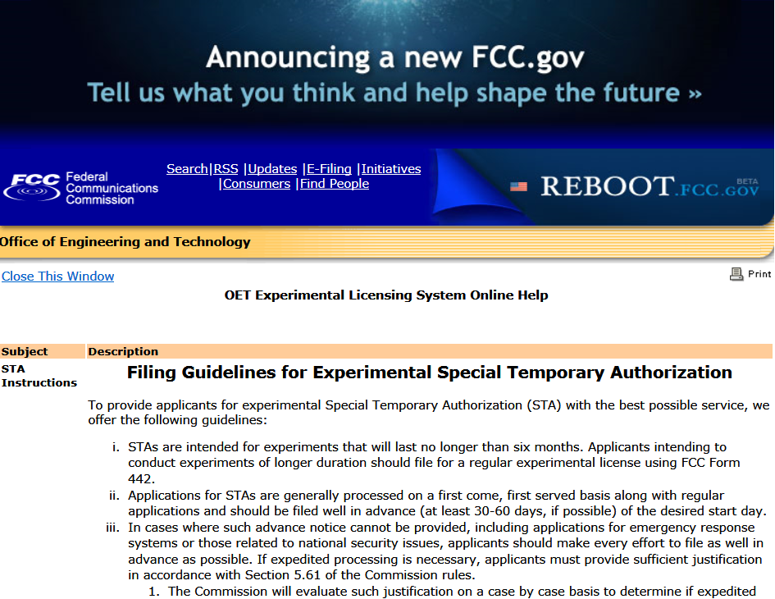
2.3 Experimental Spectrum Licenses
The Forum advocates for easy access to experimental spectrum licenses for industry and academia.
Innovation and Competition
Notes:
The Forum advocates for easy access to experimental spectrum licenses for industry and academia. Experiments, including test-beds are necessary part of the innovative environment to develop multiband, cognitive radios and DSA technologies to improve spectral efficiency. It is critical to experiment with a wide variety of technologies in order to maximize this promise. To allow this, industry and academia should be provided the maximum flexibility to engage in a wide variety of experiments. Experimental licenses are necessary for spectrum experiments to protect licensees from interference. However, mechanisms are necessary to ensure experimental licenses are issued quickly and are flexible to accommodate unique situations that will arise when experimenting with agile multi-band, cognitive radio and dynamic spectrum access technologies.

Slide 12
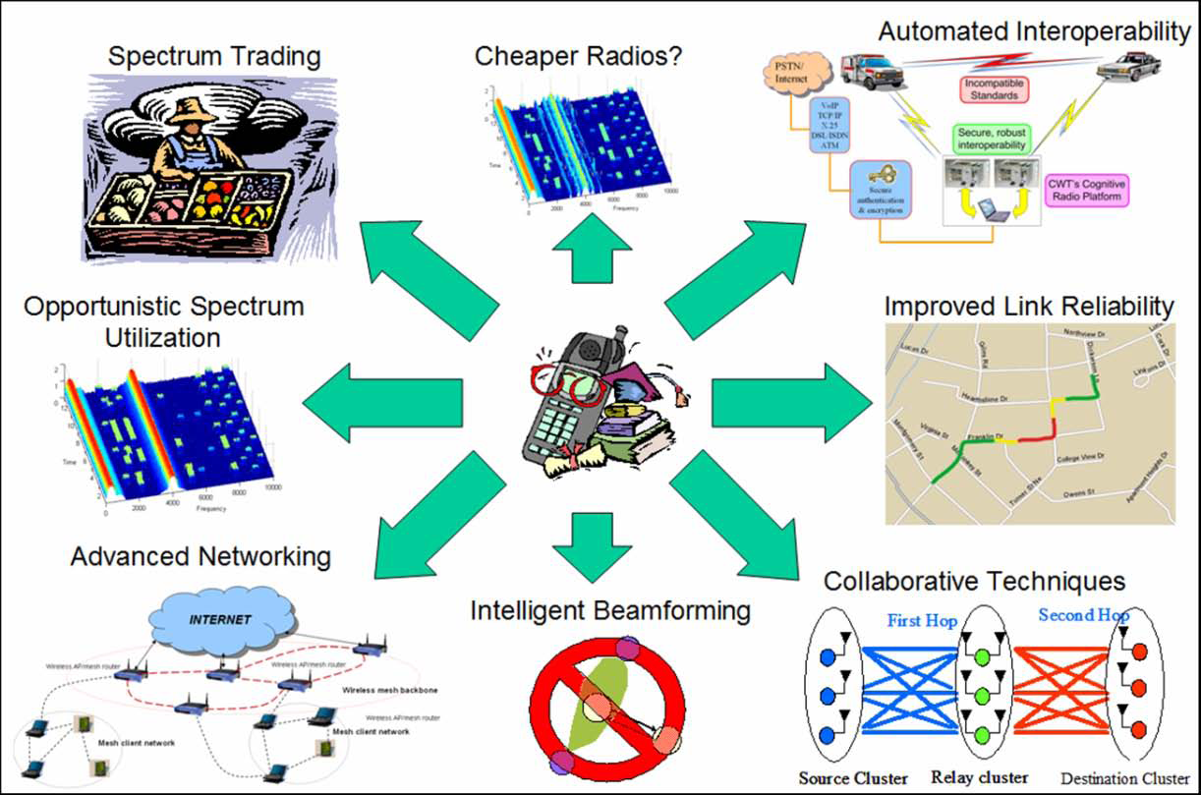
2.4 Minimizing Regulatory Barriers
The Forum advocates for minimizing regulatory barriers to entry and promotes technological innovation enabling incumbents and entrepreneurs to pursue new business opportunities throughout the wireless value chain.
Innovation and Competition
Notes:
The Forum advocates for minimizing regulatory barriers to entry and promotes technological innovation enabling incumbents and entrepreneurs to pursue new business opportunities throughout the wireless value chain. Modern flexible, market-based regulatory policies can overlay existing licensing schemes to further enable innovative technologies. Such technologies enable innovative flexible frameworks that can apply across multiple bands and wireless services. Traditional international and domestic regulatory frameworks govern access to RF spectrum based on "static" frequency allocations and assignments. The Forum advocates establishment of new, “dynamic” rules authorizing advanced wireless devices and systems to operate across a wide swath of frequency bands on a temporary, cooperative or opportunistic basis depending on the nature and characteristics of the existing authorized systems. Examples of such frameworks are given in Innovation #10 of the Wireless Innovation Forum’s Top Ten Innovations.

Slide 13
Spectrum

Slide 14
3.1 Regulatory
The Forum advocates for dedicated spectrum for Essential and Critical communications (3.1.1).
The Forum advocates for technology and service neutrality to enable innovative and efficient use of spectrum (3.1.2).
The Forum advocates a regulatory model that includes combinations of licensed and unlicensed, sharing and hierarchical, cooperative and co-existent domains for the optimal utilization of spectrum (3.1.3).
The Forum believes that reallocation of spectrum is not a sustainable basis for sound spectrum policy (3.1.4).
Spectrum
Notes:
Dedicated Spectrum for Essential and Critical Communications
The Forum advocates for dedicated spectrum for Essential and Critical communications. Dedicated spectrum is critical to the development and operation of essential and critical communications systems to support, for example; first responders, state and local public safety communities and federal Homeland Security networks. The need for immediate and prioritized access to spectrum, in emergency/crisis situations, can only be met by exclusively authorized (licensed or assigned) spectrum.
Commercially operated communications systems require similar dedicated access to exclusive-use spectrum to build the necessary business case for predictable service delivery to prospective consumers. Without a business case, founded on dedicated spectrum, commercial operators will not be able to make the large investments necessary to deliver national broadband wireless services as called for by the FCC.
Technology / Service Neutrality
The Forum advocates for technology and service neutrality to enable innovative and efficient use of spectrum. While supporting a regulatory framework of dedicated, licensed spectrum, the Forum believes that increased neutrality with respect to the specific uses of licensed spectrum will result in increased innovation in wireless applications. For example, mandating specific technology restrictions negatively impacts continued use of second-generation commercial wireless technology. In some jurisdictions, regulations still require that commercial wireless operators use Global System for Mobile Communication (GSM) in certain bands. However, no reason exists today for precluding operators from using other air interfaces within these bands. SDR base station technology can support multiple technologies using the same hardware, dynamically assigning channels in a manner that avoids any interference between them.
Multiple Licensing Models Necessary
The Forum advocates a regulatory model that includes combinations of licensed and unlicensed, sharing and hierarchical, cooperative and co-existent domains for the optimal utilization of spectrum. This approach will also permit the use of spectrum that is currently unavailable due to warehousing or is no longer used though the license remains active. While exclusive-use spectrum is a necessary regulatory condition, it is insufficient to ensure that national spectrum resources are optimally leveraged to maximum benefit. The integration of unlicensed access models and establishment of new spectrum sharing regulations, including increased tolerance of nominal levels of interference where appropriate, coupled with effective interference resolution processes are critical.
Assessment of the impact of spectrum sharing on unique legacy system that are unable to augment their systems performance must be addressed by regulatory agencies. An example of such a system is the National Science Foundation (NSF) National Radio Astronomy Observatory at Green Bank West Virginia; they may need an increase in their radio exclusion zone to mitigate the impacts.
Reallocation of Spectrum
The Forum believes that reallocation of spectrum is not a sustainable basis for sound spectrum policy. Given the complex intertwining of existing spectrum licenses, reallocation of spectrum is no longer feasible due to high cost, length of time to implement and disruption of service. A number of regulatory mechanisms exist to increase the shared use and access of selected bands, while continuing to ensure that systems can operate without disruption or harmful interference.

Slide 15
3.1 Regulatory (Cont.)
The Forum advocates allocating spectrum with licenses adapted towards a spectrum usage rights method that has the minimum necessary technical restrictions to provide adequate protection against harmful interference (3.1.5).
The Forum advocates the unified active management of spectrum (terrestrial / air / space / maritime) to maximize spectrum utilization (3.1.6).
The Forum advocates the use of receiver characteristics as part of the analysis of spectrum allocations (3.1.7).
Spectrum
Notes:
Minimize Technical Restrictions on Spectrum
The Forum advocates allocating spectrum with licenses adapted towards a spectrum usage rights method that has the minimum necessary technical restrictions to provide adequate protection against harmful interference. Optimal use of radio spectrum is more likely to be secured if the market, and not the regulator, decides what technology or service should be provided in a particular frequency band. The increase in users’ flexibility and ability to respond faster to changing market and deployment conditions will enhance the ability to increase spectrum usage efficiency. Licenses should not necessarily restrict the technology or application.
Spectrum Access Databases
The Forum advocates the unified active management of spectrum (terrestrial / air / space / maritime) to maximize spectrum utilization. The use of spectrum access databases is one important tool to enable increased sharing and thereby increase the dynamic nature of spectrum management.
Receiver Performance Critical Consideration of Spectrum Allocations
The Forum advocates the use of receiver characteristics as part of the analysis of spectrum allocations. The Forum believes that the traditional regulatory focus on transmitter emissions is insufficient to deconflict increasingly complex services within and across band allocations. The protection requirements for existing wireless communications deployments with poor receiver performance reduce the opportunity to deploy new products and services in common or adjacent spectrum segments.

Slide 16
3.2 Technology
The Forum advocates for further research and development of technologies that will improve the utilization of both managed and unmanaged spectrum.
Spectrum
Notes:
The Forum advocates for further research and development of technologies that will improve the utilization of both managed and unmanaged spectrum. Techniques such as networked databases and spectrum sensing provide real-time spectrum information that can be used in dynamic spectrum access. Small cell technology and spectrum etiquettes can be used to enable fair and efficient access to shared spectrum resources.

Slide 17
3.2 Technology (Cont.)
The Forum strongly supports the use of networked and synchronized databases accessed with device location information (3.2.1).
The Forum advocates for the use of spectrum sensing technologies to better enable cooperative, opportunistic access and recommends that advances in spectrum sensing technologies not be discounted in future regulatory and system planning (3.2.2).
Behavior and Control
RF
Emitter
Database
Policy
Sense
Environment
Behavior and Control
Location, Detections
Emitter
Database
Sense Location
Policy
Available resources
CR Protocol, Cooperative Sensing,
Synchronization
Non-Radio
DB Access
RF
Emitter
Database
Sense
Environment
Behavior and Control
Sense Location
Policy
Spectrum
Notes:
Manage spectrum access via networked databases
The Forum strongly supports the use of networked and synchronized databases accessed with device location information. These databases have emerged as a critical technology for enabling and managing spectrum access (e.g., [TVWS and 3.5 GHz NPRM]).
Basing management and policy decisions in networked and synchronized databases allow regulations and services to adapt over time and vary by band while protecting incumbent users. Networked databases provide access to information beyond what is immediately observable by a radio, thereby mitigating hidden node problems in spectrum sharing scenarios. They provide a simpler mechanism for managing upgrades to spectrum management and dynamic access schemes by updating rules in a small set of databases rather than in millions of individual radios.
Furthermore, this approach has additional foreseeable benefits in that it starts the community down a path towards gathering real-time spectrum information and awareness from many distributed users, thereby helping to achieve the real-time spectrum dashboard vision endorsed by the Forum. It also simplifies the integration and application of non-spectrum domain information into spectrum management decisions, and such a solution should scale well over time.
Databases could be made an integral part of a coexistence architecture given their visibility into the locations and operational states of many different radios from disparate wireless networks. Such a solution would need relatively rapid database responsiveness to account for changing environmental conditions. This could be helped by adopting a hierarchical architecture of databases with local caching.
However, the Forum notes that managing spectrum access in such a manner should account for the following considerations.
- The possibility of a catastrophic single-point of failure implies that the system should have redundancies built in.
- The possibility of disparate information leading to conflicting and potentially difficult to trace decisions means that these multiple redundant databases should be well-synchronized.
- Spectrum sharing systems leveraging networked databases have a greater need for secure communications and authentication due to the potential for impacting a large number of systems.
- Further, as with all databases, there exists the possibility of incomplete or erroneous information.
Thus there is value to incorporating fail-safe mechanisms, such as spectrum sensing, which could provide a mechanism for assessing the presence of protected users independently of databases.
Spectrum Sensing
The Forum advocates for the use of spectrum sensing technologies to better enable cooperative, opportunistic access and recommends that advances in spectrum sensing technologies not be discounted in future regulatory and system planning.
A Spectrum Sensing Device intelligently detects whether a band of electromagnetic spectrum within radio frequencies is currently in use. Technologies for Spectrum Sensing include both non-Cooperative (e.g. matched filters, energy detection, cyclostationary analysis, wavelet analysis, and covariance detection) and Cooperative sensing. Cooperative sensing helps to improve detection by providing readings from multiple users who collaborate with each other to refine non-cooperative spectrum sensing devices. Cooperative sensing provides both users and network administrators an appropriate spectrum context for implementation and optimization of policy based spectrum management. Multiple independent observations may be useful in identifying hidden nodes, minimizing false alarms, and may provide more accurate signal detection.

Slide 18
3.2 Technology (cont.)
The Forum advocates the use of spectrum sharing and small cell technologies (3.2.3).
The Forum considers spectrum etiquettes an important regulatory tool for maximizing the economic and social benefit of the electromagnetic spectrum (3.2.4).
The Forum advocates legacy users augmenting their existing systems, where possible to facilitate cooperative sharing of spectrum (3.2.5).
Spectrum
Notes:
Spectrum Sharing and Small Cell Technologies
The Forum advocates the use of spectrum sharing and small cell technologies. The Forum believes that clearing and reallocating Federal Spectrum is not a sustainable basis for spectrum policy due to high cost, length of time to implement and disruption to the mission of essential and critical communications. The Forum recommends the use of new technologies, and paradigms such as spectrum sharing and small cells that address the emerging spectrum crisis. These recommendations have been supported by the work of the Forum, its members and its partners over the past several years including work by the Forum’s Cognitive Radio Work Group on quantifying the benefits of cognitive radio technologies including spectrum sharing. Spectrum sharing was explored in the use cases developed by the Forum’s Public Safety Special Interest Group for cognitive radio. The report by the Public Safety Special Interest Group identified advanced radio technologies as key to realizing innovative partnerships that would allow public safety to benefit from more efficient spectrum utilization. These latter reports acknowledge spectrum sharing as an important component of future public safety communications capabilities, given the unique incident-based spectrum and capacity requirements of the public safety community.
Spectrum Etiquette
The Forum considers spectrum etiquettes an important regulatory tool for maximizing the economic and social benefit of the electromagnetic spectrum. Spectrum etiquettes determine principles of operation which the radio must consider when making its decisions, and offer a means to share spectrum resources in an efficient and fair manner. The Forum believes that rules defining performance criteria for spectrum etiquettes may need to be promulgated in order for the benefits of spectrum etiquettes to be realized, but that the etiquettes themselves need not be regulated. The Forum also encourages open testing and simulation of etiquettes to facilitate innovation that would improve spectrum efficiency and to assure that etiquette performance objectives are being met.
Cooperative Sharing
The Forum advocates legacy users augmenting their existing systems, where possible to facilitate cooperative sharing of spectrum. There is an inherent inefficiency of spectrum etiquettes that do not account for the presence or behavior of other radio systems. To share spectrum, radio systems’ operational parameters are implemented so both systems have access to the spectrum. While many parameters such as transmitted power (e.g., transmit power control), frequency (e.g., dynamic frequency selection) and time (e.g., predictive scheduling) directly impact coexistence metrics and are obvious candidates for cognitive radio control, many other parameters can be set to ensure and enhance coexistence such as route selection (choosing routes to minimize interference), network association (preferentially connecting to a network with greater protective measures), and application layer parameters (such as reducing video quality which reduces occupied bandwidth). Conceptually, virtually every parameter, setting, and/or process which influences the transceiver operations of a radio can be controlled to ensure or enhance the coexistence of cognitive radio systems with other users.
Out of necessity, most proposed techniques for gaining information about legacy systems (e.g., TV or satellite) adopt a non-cooperative approach, where the cognitive radio system has to gain relevant information without help from the incumbent. Cooperative techniques such as has been proposed for systems utilizing a Radio Environment Map database are therefore generally limited to use for coexistence between cognitive radio systems accessing available “white space”. However, this need not be the case as with the proper inducements, legacy users could augment their existing systems to aid cognitive radio systems’ observation and orientation processes. This includes registering accurate transmitter and receiver characteristics for legacy radio systems with the radio environment map database.
The members of the Forum endorse this approach, which allow for the design, development and standardization of a “spectrum dashboard” providing a real time or near real time view of the radio environment map at a given location and at a given time. Such a dashboard will be a key tool in determining the etiquettes that the cognitive radio must consider when making its decisions.

Slide 19
3.3 Standards
The Forum considers harmonized standards to be an important stepping-stone toward the broad deployment of wireless communications worldwide (3.3.1).
The Forum advocates the use of existing and emerging transmit, receive and interference regulatory standards to facilitate use of Spectrum System Interfaces (SSI) that enable a wide range of spectrum sharing opportunities (3.3.2).
Spectrum
Notes:
Harmonized Standards
The Forum considers harmonized standards to be an important stepping-stone toward the broad deployment of wireless communications worldwide. Harmonized standards can benefit five key players in the wireless communications value chain:
- Developers benefit from minimal risk in new product development and service development
- Manufacturers benefit from a single set of technical requirements and an increased range of potential customers across a wider range of countries
- Network operators benefit from having an increased range of equipment manufacturers and an increased customer base
- Consumers benefit from the opportunity to purchase equipment from a wide range of manufacturers and can have a better choice in the price that they are willing to pay
Investors benefit from an increased market size, cost reductions, and risk minimization
Spectrum System Interfaces
The Forum advocates the use of existing and emerging transmit, receive and interference regulatory standards to facilitate use of Spectrum System Interfaces (SSI) that enable a wide range of spectrum sharing opportunities. Spectrum sharing between legacy communication platforms and modern Cognitive and Policy based communication systems requires clear and accurate standards development, compliance and harmonization. The Forum is committed to development of regulatory standard that enable efficient use and repurposing of spectrum. New regulation should enable and encourage innovation in both commercial and mission critical communications as technology for radios, networks and users continue to evolve.
The Forum believes a key principle of well defined and enforced spectrum regulation is to “do no harm” to legacy users, operators, or commercial and mission critical communications developers that provide new products capable of spectrum sharing and innovations needed to improve spectrum utilization.
Transmitter Standards: Legacy transmitter standards for both commercial and mission critical communications evolved over the years without a requirement for spectrum sharing. For the most part transmitter standards specify static behavior of the in-band and out-of-band characteristic of a transmitter used in an assigned spectrum allocation. The Forum believes as industry provides cognitive and policy based communication systems capable of adaptation to its own RF environment, transmitter standard will need to be harmonized with diverse user requirements to support spectrum sharing and needed improvements in spectral efficiency.
Receiver Standards: Dedicated spectrum license policies and lack of legacy receiver standards encouraged development and deployment of low cost receiver technology that in many cases lack the robustness necessary to allow spectrum sharing. The Forum believes development of receiver standards is critical to support both spectrum repurposing and sharing. Forum sponsored projects on receiver standards are in place and will address the role of receiver standards in preparing for next generation innovation and advancement in communication technology for both dedicated and shared spectrum.
Interference Standards: The Forum believes development of interference standards that harmonize transmit and receive standards with Spectrum Consumption Models (SCM), Model-Based Spectrum Management (MBSM) systems, geolocation databases and user access policies will be required to fully implement proposed regulations for repurposing and sharing of licensed and unlicensed spectrum.
The Forum believes support, development and harmonization of appropriate transmit, receive and interference standards are critical enable spectrum managers to optimize spectrum utilization for ALL commercial and mission critical communication platforms.

Slide 20
3.3 Standards (Cont.)
The Forum believes that the role of receiver parameters in standards and their related consideration in spectrum engineering should receive greater prominence in order to enhance spectrum efficiency and to help maximize value to the economy and society (3.3.3).
Spectrum Unusable Due to consumer GPS RX Design
LightSquared-held Spectrum
LightSquared-held Spectrum
LTE DWN 1
LTE DWN 2
LTE UP 1
LTE UP 2
1525
1559
1565
GPS (20MHz BW)
1585
1605
1610
1626
1660.5
Spectrum
“Consumer” GPS
Notes:
The Forum believes that the role of receiver parameters in standards and their related consideration in spectrum engineering should receive greater prominence in order to enhance spectrum efficiency and to help maximize value to the economy and society.
- The Forum believes much benefit can be achieved in terms of spectrum efficiency through this approach while at the same time reducing risk for new market and new technology entrants
- Receiver parameters play a fundamental role in flexible spectrum usage and management because the defined protection approaches are a function of the receiver parameters e.g. sensitivity, blocking, and protection ratios
- Improvements in technology and manufacturing processes have greatly reduced the costs for components designed to improve receiver performance. It is the Forum’s belief that there is now little or no economic penalty for improving receiver performance in new products.
- Furthermore, the Forum believes that the protection of an existing wireless communications system with a poor receiver performance would hamper the introduction of a new technology.
- Receiver parameters included in harmonized standards would have an impact on equipment specifications, which would improve the performance of existing radio applications and further support the deployment of new wireless communications products and services.

Slide 21
SECURITY
Notes:
It is the Forum’s view that the proper application of security services and mechanisms, when based on a conscientiously developed security policy formed from a defined threat model and risk assessment, can provide the security architecture and design necessary to ensure the integrity reliability and availability of our nations Emergency and Critical Communications systems.

Slide 22
4.1 Security Considerations
The Forum advocates security is considered throughout the design, development and deployment of systems utilized for essential and critical communications.
Table 1: Threat Classes
Denial of Service
Unauthorized Access
Eavesdropping
Masquerade
Modification
Repudiation
Replay
Security
Notes:
International and domestic terrorist organizations especially those supported by rogue nations, have access to resources that can enable damaging and potentially crippling attacks on our nation’s E&CC systems. The possible threats range from overt attacks on the physical components to insider attempts to subvert the operational software controlling the components of the systems. These threats may be present during the design and development, manufacturing or operational phases of a system, and in particular for the new nationwide LTE network planned for first responders.
The Wireless innovation forum has published a report outlining a process which identifies potential threats and vulnerabilities and leads to the development of security policies at the organizational, system and individual platform level. These security policies specify the criteria and measures needed for protection and mitigation of designated threats throughout the entire lifetime of a system and its component elements.
The process includes identification of assets which require protection. These include but are not limited to information, security operating parameters and data, embedded software, hardware components and virtually any infrastructure component including dispatch centers, servers, routers relays, base stations and individual radio platforms. Threat and vulnerability analyses must tailor for each asset as is the risk assessment estimating the probability that any given threat/vulnerability may be realized. With this process completed then specific security measures and mitigation methods can be developed which can be applied to the design, manufacture and operation of the system and its various component elements. These security measures, methods and design requirements then form the basis of the various Organizational, System and Platform security policies which govern the design, manufacturing, operation and maintenance and decommissioning of the system and its components.

Slide 23
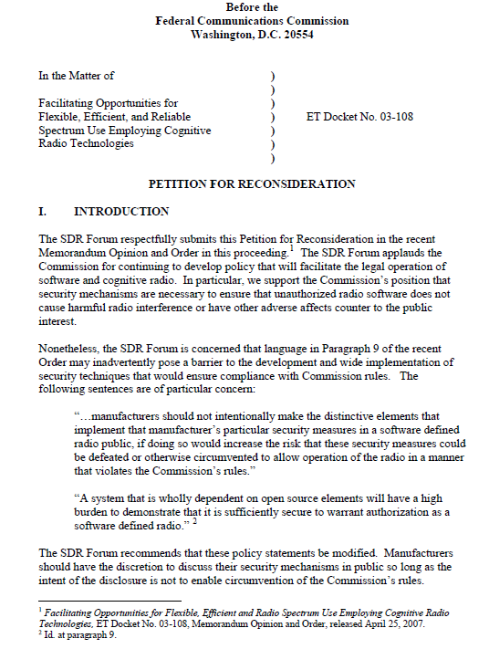
4.2 Avoid Security by Obscurity
The Forum advocates that Regulators' focus on development and application of policies and standards that enable communication systems and platforms to protect all sensitive information and data.
Security
Notes:
The Forum advocates that Regulators' focus on development and application of policies and standards that enable communication systems and platforms to protect all sensitive information and data. A common misconception about security is that it is always enhanced through secrecy. In practice, some elements of a security framework should remain secret while others should not. An attempt to achieve security by keeping the methods confidential is often termed “security through obscurity.” History repeatedly has shown that “security through obscurity” often fails, typically because it precludes a broad and rigorous review that would uncover its flaws and enable experts to fix shortcomings.
Some obvious examples of what is required to remain secret in a security framework are keys, passwords, and biometric data that provide various forms of access control. For example, if a product based its security on publicly available cryptography for which there has been no known failure, then if a key is ever compromised, simply replacing the key may return security to its original state for all transactions going forward.

Slide 24
4.3 Open Source Security
The Forum advocates Regulators adopt a neutral policy on security of Open Source elements because these elements are, a priori, no less secure than proprietary approaches.
Security
Notes:
The Forum advocates Regulators adopt a neutral policy on security of Open Source elements because these elements are, a priori, no less secure than proprietary approaches. While there is active debate on the security posture of open source software, considerable evidence exists that open source code typically is more secure than proprietary code. The reason is that open source code is exposed to a wide range of experts with an interest in the success of the software and the willingness to update it to correct identified flaws. Thus it is important that any open source code used for Essential and Critical communication systems are actively supported and vetted by a forum of independent evaluators and contributors.
Some of the most successful security techniques in information and communications technology today are based on open source approaches. For example, most web-based e‑commerce transactions today use a technique called Secure Socket Layer (SSL), which is also referred to as Transport Layer Security (TLS). The specification for SSL was vetted through the open processes of the Internet Engineering Task Force. IPSEC V.4 and V.6 are examples of other security protocols, which are essential to security on the internet and are mandated for use on systems used by US Government. Thus the Forum urges that Regulators should remain neutral with respect to open source security methods. Academic inquiry and industry discussion coupled with a market test is more likely to lead to the correct outcome with respect to the open source debate than regulatory intervention.

Slide 25
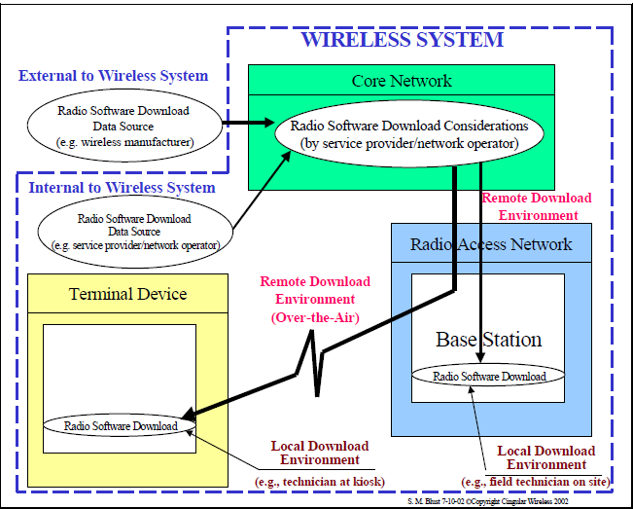
4.4 Over the Air Software Reconfiguration
The Forum advocates regulators allow Over the Air software reconfiguration of software and radio platform operating parameters.
Security
Notes:
The Forum advocates regulators allow Over the Air software reconfiguration of software and radio platform operating parameters. Software defined radio technology affords many different opportunities for over the air configuration and control of radio platform operations. These range from the downloading of machine interpretable policies applicable to security, routing, Quality of Service, cognitive behavior as well as updates to platform operating system software and applications. Security methodologies and mechanisms exist to enable secure transmission of waveforms, policies and reconfiguration data.
The Wireless Innovation Forum recognizes the need for security in any download or other over the air operation of wireless devices and infrastructure. The Forum released the first report on security in 2002 and has since released three additional reports,,,. These reports cover the broad issues relating to security for wireless devices employing SDR technology to specific requirements for downloading software and software provisioning.
In our latest report “Securing Software Configurable Communication Devices” specific services, methodologies and mechanisms are identified which applied in combination with others can provide the security necessary to ensure the integrity reliability and accuracy of the relevant over the air operation. Examples of applicable Services and Mechanisms can be found in Chapter 3 of this document include the interworking of mechanisms such as access control, authentication, integrity, encryption, software version control. The applications of these services as examples in these processes are replete throughout the document including chapters 3, 6 and 7

Slide 26
COMMUNICATIONS INTEROPERABILITY
Notes:
The Forum promotes standards, technologies, and regulatory policies to enhance interoperability and co-existence among essential and critical communication systems. We continually investigate a wide spectrum of interoperability techniques using SDR and CR technologies ranging from evolutionary improvements of traditional approaches to revolutionary new methods that utilize more advanced emerging technologies.

Slide 27
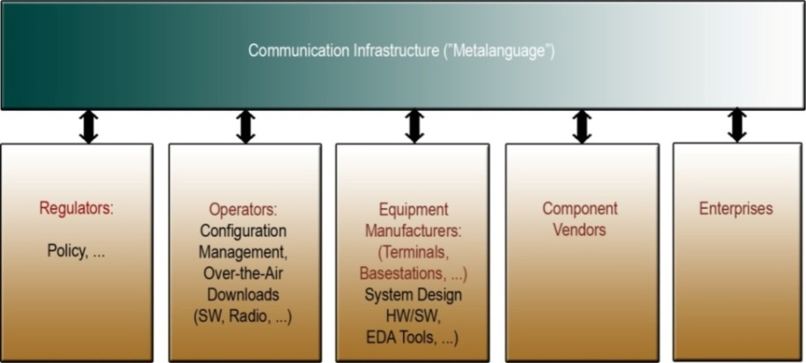
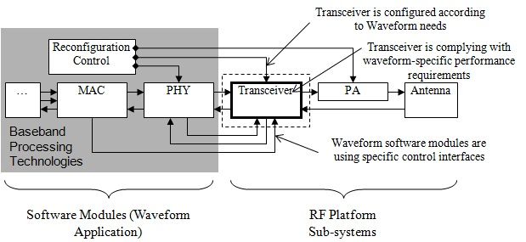
5.1: Openly Developed Industry Requirements and Standards
The Forum advocates the use of openly developed industry requirements and architectural standards that lead to interoperable products and systems.
Communications Interoperability

Slide 28
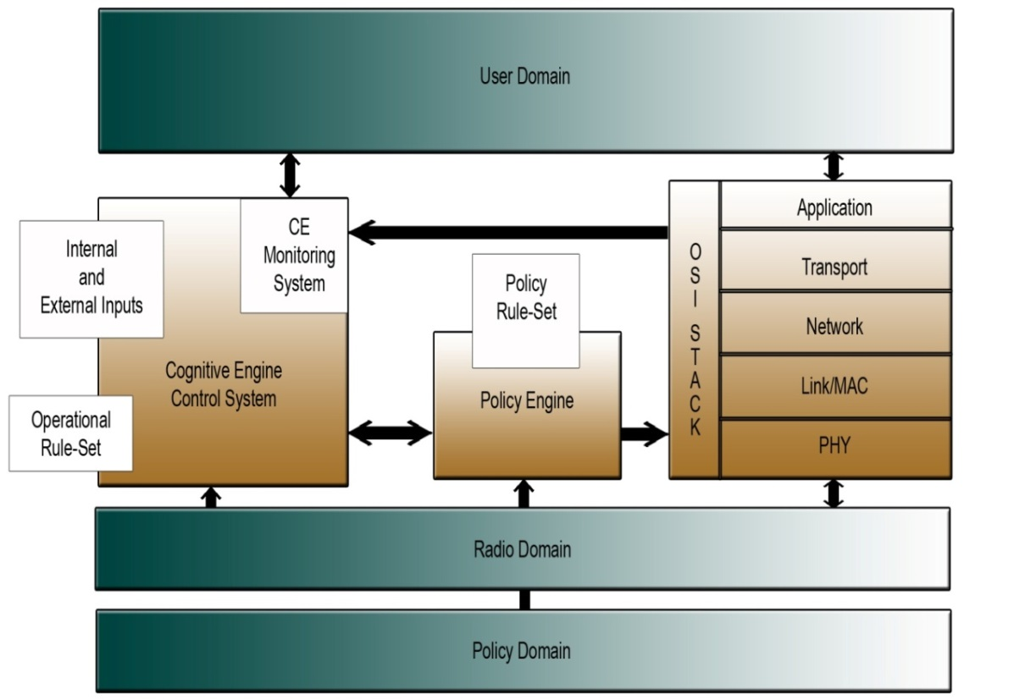
5.2 SDR and CR Technologies Enable Interoperability
The Forum advocates interoperability innovations enabled by software defined and cognitive radio technologies native to end user radio equipment and systems.
Wireless Innovation Forum Cognitive Radio Concept Architecture
Communications Interoperability
Notes:
The Forum advocates interoperability innovations enabled by software defined and cognitive radio technologies native to end user radio equipment and systems. One innovation, multiband radios which enables interoperability across bands in a single radio providing lower SWAP-C (Size, Weight, Power and Cost). Interoperability can be expanded with wide spectral range RF front ends identified on the Forum’s “Top 10 Most Wanted Innovations” list. The Forum also supports solutions to more recent interoperability needs that have arisen with the public safety broadband data initiative, such as ability of higher stack layers (such as data applications) to communicate, standards and technologies for communication/interoperation of voice over IP, and interoperability of direct mode communications. Other innovations include “smarter” gateway devices using cognitive radio techniques that reduce traditional problems with their setup and operation. Cognitive radio techniques can also enable “smarter” and more automated reconfiguration of networks, in essence creating a large “virtual network” of smaller interoperating networks. At the revolutionary end of the interoperability methods spectrum, the Forum promotes new techniques that extensively utilize SDR and CR, such as policy based radios and networks.
Top 10 Most Wanted Wireless Innovations – 2013; WINNF-11-P-0014-V2.0.0, Innovations # 4 and #6 pg 4-5; http://groups.winnforum.org/d/do/6206

Slide 29
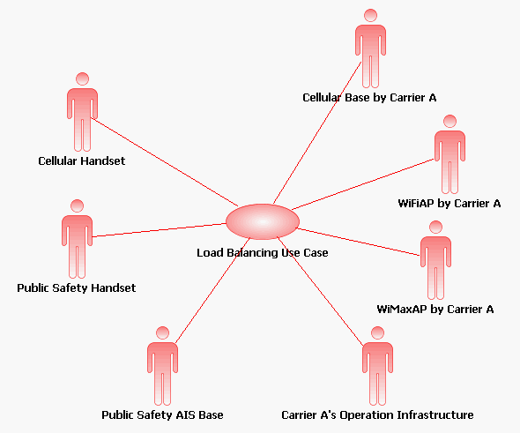
5.3 Top Down Methodology
The Forum advocates a “top down” methodology, including the development of use cases, for identifying technology gaps for any wireless technology study.
Communications Interoperability

